Slide 1

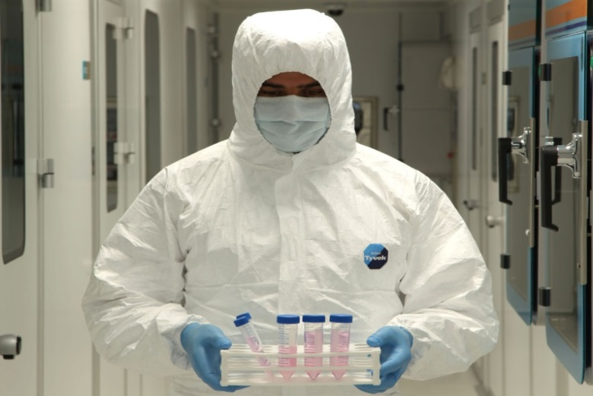

STEM CELL THERAPIES IN RETINAL DEGENERATIONS
Prof.Dr. Ayşe Öner, FEBO
Erciyes University Medical Faculty
Ophthalmology Dept. KAYSERİ

Slide 2
I have no financial interest to disclose

Slide 3
MAIN TOPICS
What is stem cell?
What are the types and properties of stem cell?
Applications in retinal diseases?
Our clinical phase 1 study?

Slide 4
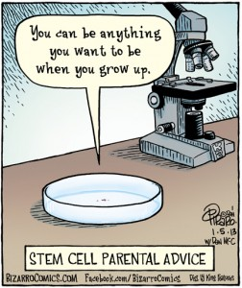
WHAT IS STEM CELL?
Stem cell:
Basic, pure, unspecialized form of cell.
Has the potential to develop into many different cell types in the body.
Repair damaged cells and tissues

Slide 5
History of Stem Cells
1981: Discovery of embryonic stem cells from early mouse embryos.
1998: Stem cells from human embryos are derived in the laboratory and called human embryonic stem cells (hESCs)
2006: Researchers "reprogrammed" some adult cells to behave like an ESC ( induced pluripotent stem cells) (iPSCs),
2009: With the permission of the FDA, the first hESC clinical trial was approved for spinal cord injury.

Slide 6
UNIQUE PROPERTIES OF SC
Self-renewal
Differentiation
Proliferation

Slide 7
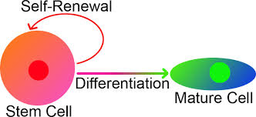
PROLIFERATION-SELF-RENEWAL
Proliferation: Stem cells are capable of dividing and replicating themselves for long periods.
Self –renewal: After division, it can continue as a stem cell, like the parent stem cells.

Slide 8
DIFFERENTIATION
Differentiation: When unspecialized stem cells give rise to specialized cells, the process is called differentiation.
There are internal and external signals during differantiation.
The internal signals are controlled by a cell's genes
The external signals for cell differentiation include chemicals secreted by other cells, physical contact with neighboring cells, and certain molecules in the microenvironment.

Slide 9




POTENCY OF SC
Totipotent
Pluripotent
Multipotent
Oligopotent
Unipotent

Slide 10
Totipotent:
Unlimited proliferation capacity
Are able to differentiate into embriyogenic and extra embriyogenic cells.

Slide 11
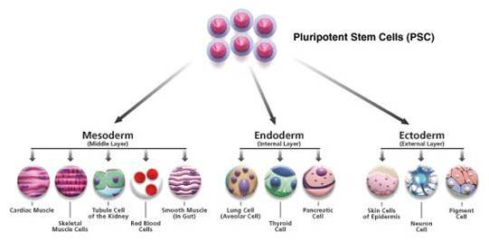
Pluripotent:
Capacity to differentiate into embriyogenic cell layers (endoderm, mesoderm, ectoderm)

Slide 12
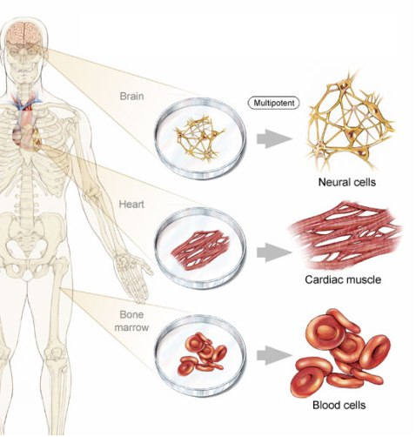
Multipotent
Capacity to differentiate limited types of cell types.

Slide 13
TYPES OF STEM CELLS
1-EMBRYONIC STEM CELLS
2- ADULT STEM CELLS
- Mesencymal SC
- İnduced Pluripotent SC
3-CORD BLOOD STEM CELLS
4- AMNIOTIC FLUID STEM CELLS

Slide 14
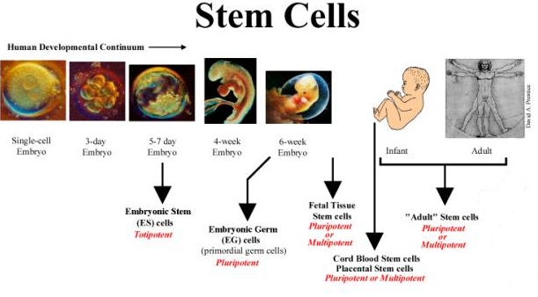
ORIGIN OF STEM CELLS

Slide 15

Embryonic (ES) SC and Foetal SC
Derived from human embryos that are few days old or foetus
Differentiate to any type of cell.
Can be grown easily but difficult to manipulate.
Tumor formation, hyperproliferation and possibility of rejection

Slide 16
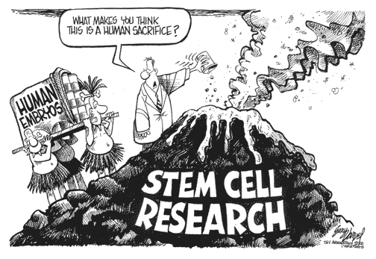
ETHICAL ISSUES- EMBRYO IS DESTROYED

Slide 17
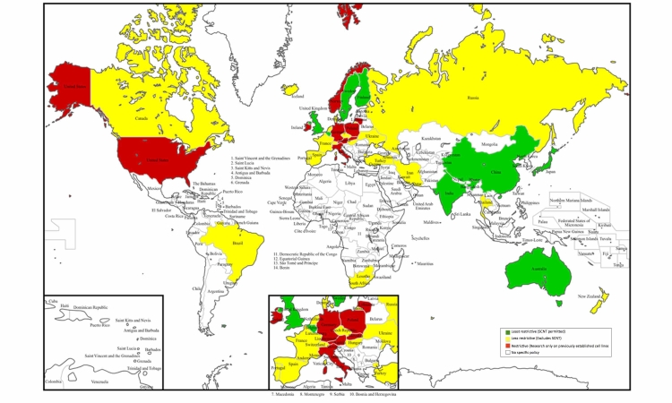
hESC MAP

Slide 18
Adult SC
Found in all humans and can be obtained easily
Differentiate to a limited number of cell types
Maintain and repair the tissue in which they are found.
Tumor formation and rejection is less likely

Slide 19
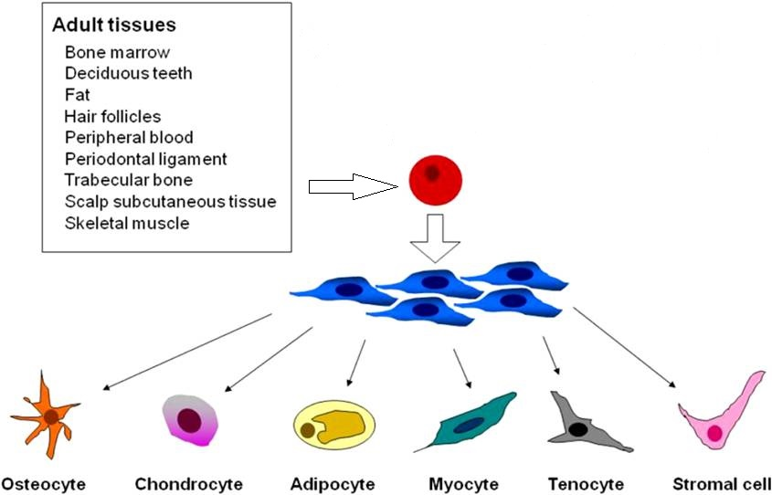

Slide 20
Induced Pluripotent SC (IPSC)
Adult somatic cells reprogramed to become like embryonic stem cells (induced pluripotent stem cells, iPSCs)
Viruses are currently used to introduce the reprogramming factors (OCT4, SOX2, KLF4 and c-MYC) into adult cells.
Limited availibility with difficult techniques.
Cost is high.
Tumor formation and rejection are the problems.

Slide 21
STATUS IN OUR COUNTRY
Human ESCs are restricted in our country (2005)
Adult SCs and IPSC can be used with the approval
of Local Ethical Committee and Ministry of Health
(Please read TCK: 90)

Slide 22
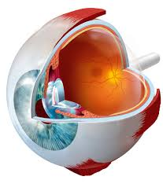
SC in OPHTALMOLOGY
CORNEA AND RETINA

Slide 23
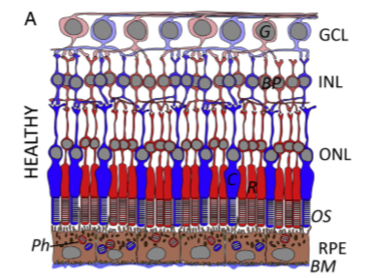
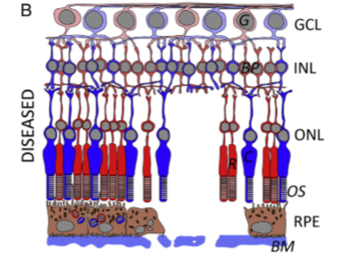
SC in RETINAL DISEASES
Very complex tissue
Has 10 different layers and 9 types of cells connected with each other.
An alteration or damage in any of these layers can impair the anatomy and functions of the retina.

Slide 24
Mechanisms of Stem Cell Therapy
THERE ARE FOUR MECHANISMS:
(1) Cell replacement: Healthy stem cells can replace degenerated cells
(2) Nutritional support: Healthy stem cells secrete some trophic factors and promote the survival of surrounding cells.
(3) Upregulating antiapoptotic genes and nutritional factors.
(4) Promote new synaptic connections.

Slide 25
Advantages of SC Use in Eye
Relatively small number of cells and low doses required
Easy accesibility for surgery
Direct visualization of grafts
İmmun privilige of the eye
One eye can be used as control in bilateral disease
Rare extraocular distribution.

Slide 26
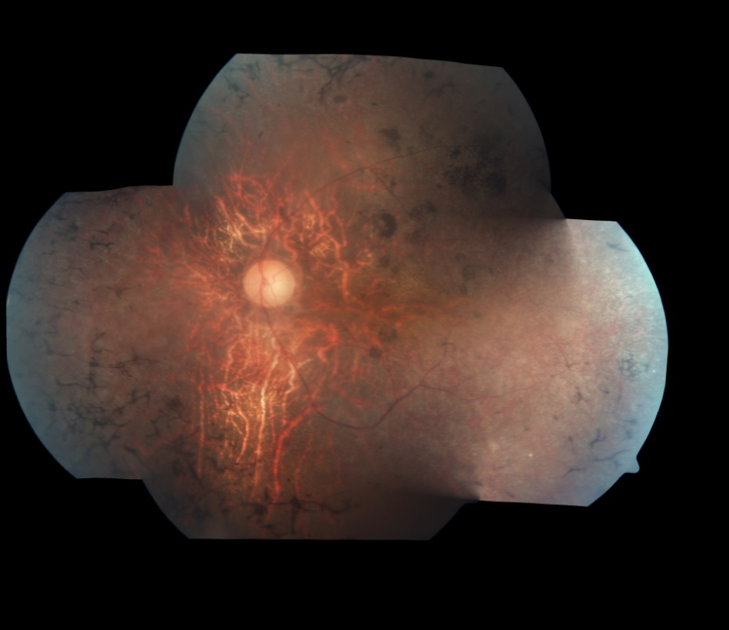
TARGET RETINAL DISEASES ARE THE DISEASES
WITH NO DEFINITIVE TREATMENTS

Slide 27
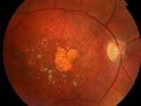
Age Related Macular Degeneration (AMD)

Slide 28
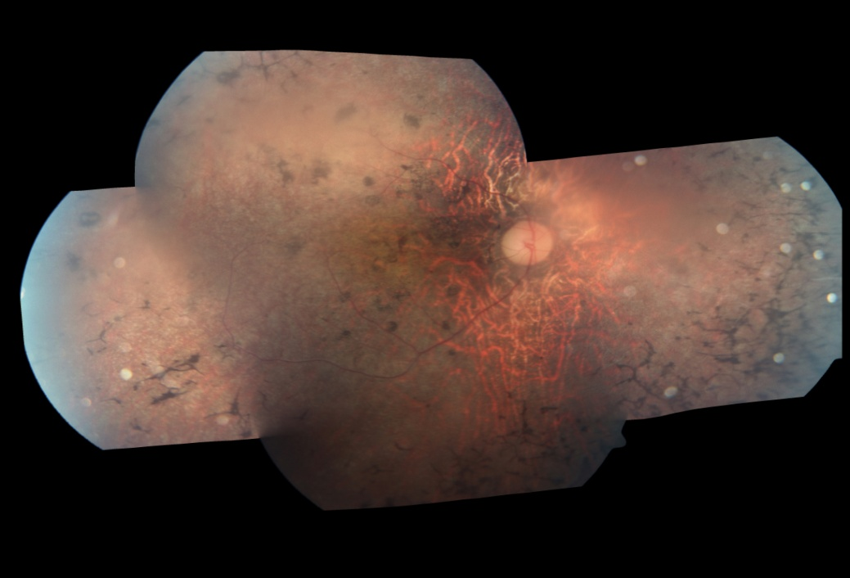
Retinitis Pigmentosa

Slide 29
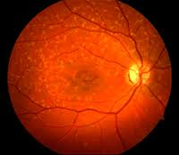
Stargardt’s Macular Dystrophy

Slide 30
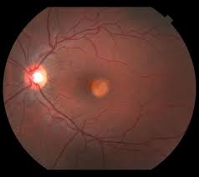
Best’s Vitelliform Macular Distrophy

Slide 31
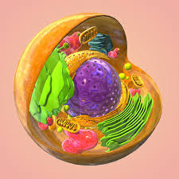
WHICH KIND OF STEM CELLS
CAN BE USED IN RETINAL DEGENERATIONS?

Slide 32
REGISTERED TRIALS WITH ESC clinicaltrials.gov
(1) (NCT01469832) Safety and Tolerability of Sub-retinal Transplantation of hESC-RPE Cells in Patients with Stargardt's Macular Dystrophy (SMD)
(2) (NCT01691261) A Study of Implantation of hESC-RPE Subjects with Acute Wet AMD and Recent Rapid Vision Decline
(3) (NCT01674829) A Phase Ⅰ/Ⅱa, Open-Label, Single-Center, Prospective Study to Determine the Safety and Tolerability of Subretinal Transplantation of hESC-RPE (MA09hRPE) Cells in Patients With Advanced Dry AMD
(4) (NCT02122159) Research With Retinal Cells Derived From Stem Cells for Myopic Macular Degeneration
(5) (NCT01344993) Safety and Tolerability of Sub-retinal Transplantation of hESC Derived RPE (MA09-hRPE) Cells in Patients with Advanced Dry AMD
(6) (NCT01345006) Sub-retinal Transplantation of hESC Derived RPE (MA09-hRPE) Cells in Patients with Stargardt's Macular Dystrophy;
(7) (NCT01625559) Safety and Tolerability of MA09-hRPE Cells in Patients with SMD.

Slide 33
REGISTERED CLINICAL TRIALS WITH IPSC clinicaltrials.gov
(1) (NCT02162953) Development of Induced Pluripotent Stem Cells from Patients with Best Disease and Other Inherited Retinal Degenerative Diseases
(2) (NCT01432847) Generation of induced pluripotent stem (iPS) Cell Lines from Somatic Cells of Participants with Eye Diseases and from Somatic Cells of Matched Controls.

Slide 34
Registered Clinical Trials with BMDMSC
1) NCT01736059- Clinical Trial of Autologous Intravitreal Bone-marrow CD34+ Stem Cells for Retinopathy. Non-exudative AMD, Diabetic Retinopathy. RVO, RP, Hereditary Macular Degeneration.
2) NCT01560715- Autologous Bone Marrow-Derived Stem Cells Transplantation For RP (RETICELL)
3) NCT02280135- Clinical Trial of Intravitreal Injection of Autologous Bone Marrow Stem Cells in Patients With Retinitis Pigmentosa (TC/RP)
4)NCT01068561- Autologous Bone Marrow-Derived Stem Cells Transplantation For Retinitis Pigmentosa
5) NCT01914913- Clinical Study to Evaluate Safety and Efficacy of BMMNC in Retinitis Pigmentosa
6) NCT01531348-Feasibility and Safety of Adult Human Bone Marrow-derived Mesenchymal Stem Cells by Intravitreal Injection in Patients With Retinitis Pigmentosa
7) NCT01518127-Intravitreal Bone Marrow-Derived Stem Cells in Patients With Macular Degeneration (AMDCELL)

Slide 35
Registered Trials with ADMSC
(1) (NCT02024269) Study to Assess the Safety and Effects of Cells Injected Intravitreal in Dry Macular Degeneration
(2) (NCT02144103) Effectiveness and Safety of Adipose-Derived Regenerative Cells for Treatment of Glaucomatous Neurodegeneration.

Slide 36
OUR CLINICAL STUDY
Phase 1 prospective safety study.
Approval of the Ethical Committee of University (March-2014)
Approval of Ministry of Health (January-2015)
20 Volunteers with end-stage RP

Slide 37
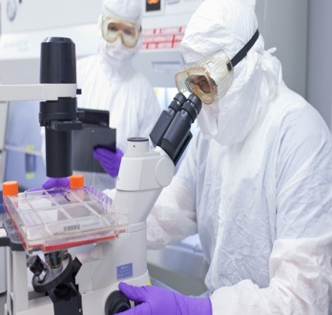

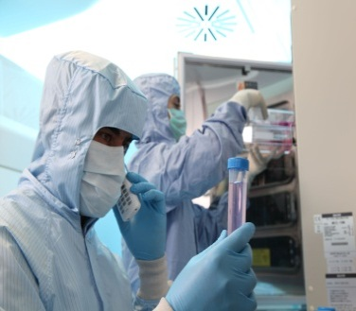
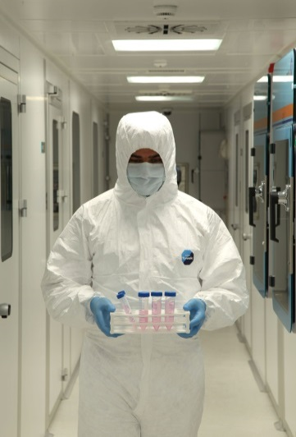
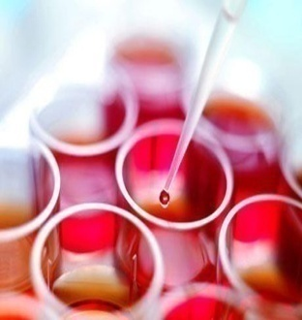
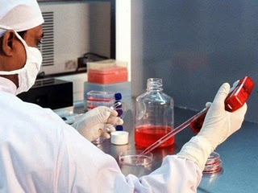
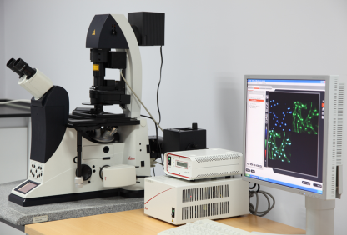
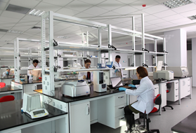

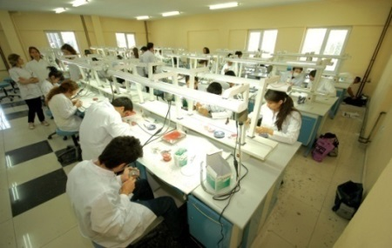
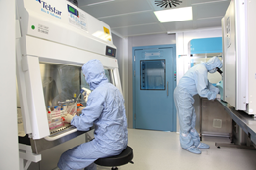
GENKÖK

Slide 38
PATIENTS AND METHODS
15 patients were included
All had total visual field defect.
% 50 of the patients were only p +
The best VA was hand motion from 1 meter.
All had undetectable ERG.
The worse eye was operated.
After total vitrectomy with 23 gauge, 1.000.000 SCs were injected subretinally.
Adipose Tissue Derivated MSC s were used.

Slide 39

GMP (Good manufacturing practice)
ADMSCs were prepared under strict environmental conditions
with international standarts

Slide 40
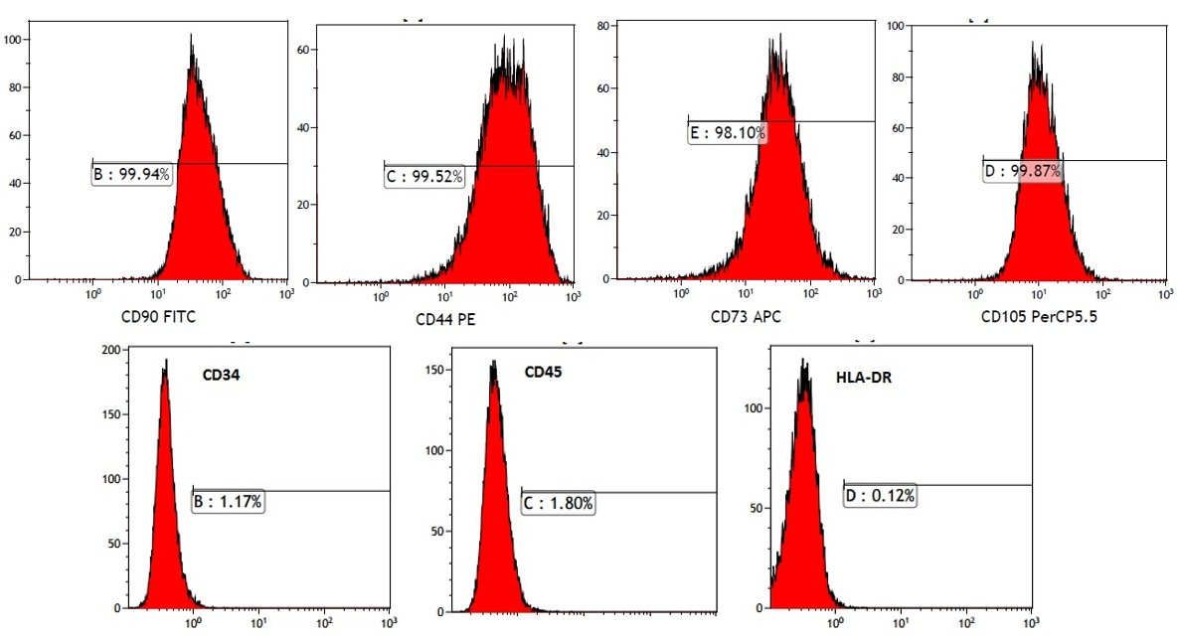
Allogenic human adipose derived MSCs
flow cytometry results
Notes:
Allogenic human adipose derived MSCs flow cytometry results showed CD90,44,73 AND 105 POSİTİVE AND 34-45-HLA-DR negative

Slide 41
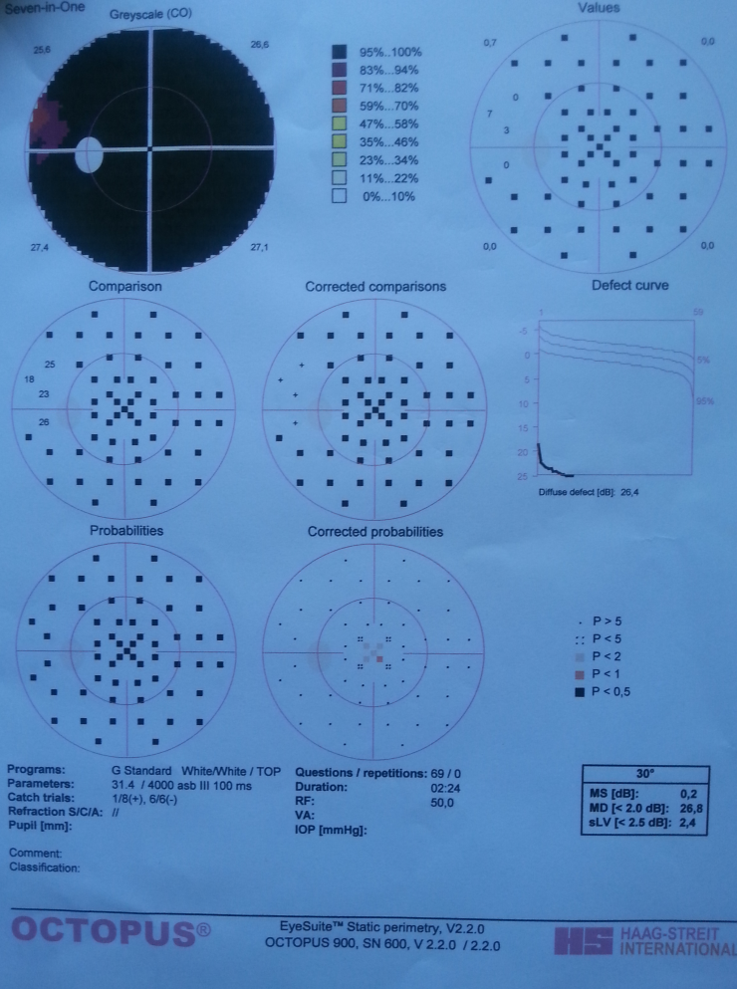
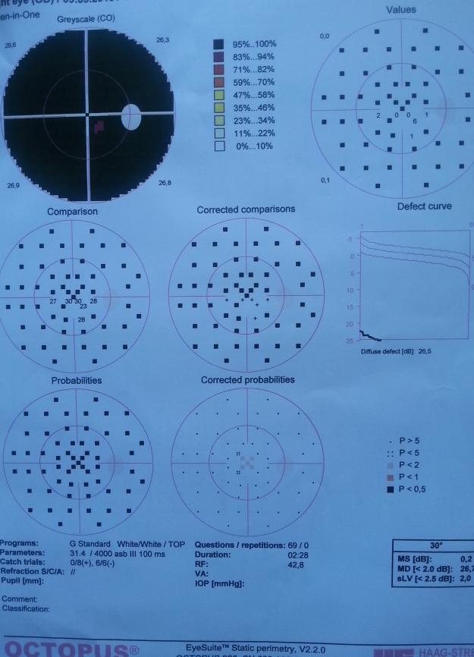
Two examples for visual field examination

Slide 42
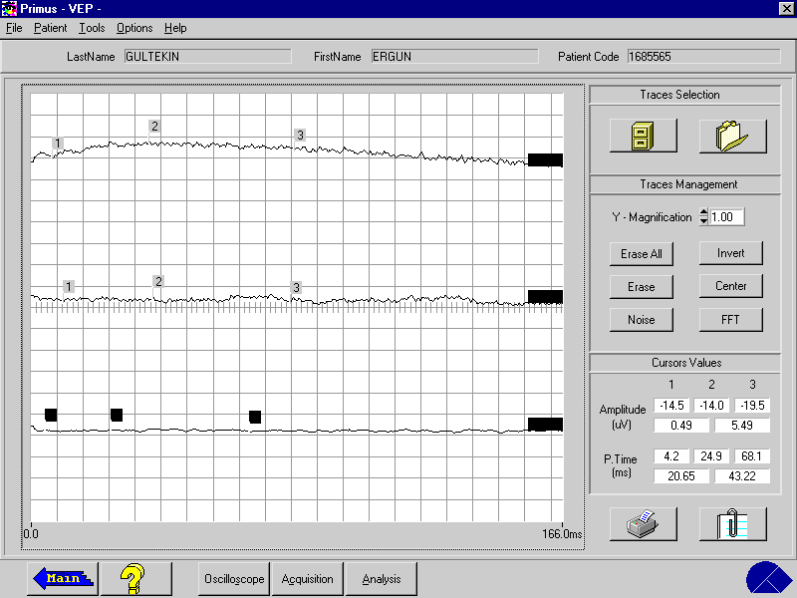
An example for ERG

Slide 43
RESULTS
11 patients completed 12 month follow-up.
None of them had systemic complications.
5 had no ocular complications.
One had CNVM at the transplantation site and received intravitreal anti-VEGF drug for once.
(Surgical trauma to the Bruchs membrane)
5 had ERM around the transplantation area and at the periphery and received second PPV (vitreal reflux of the stem cells or inadvertent preretinal injection of SC)

Slide 44
RESULTS
Only 1 had visual acuity improvement (From 1 mhm to 0.05) and a slight ERG improvement .
3 mentioned that the light and some colors are brighter than before although there was not an improvement in VA.
The other 7 had no VA improvement
(6 of them were p+ )

Slide 45
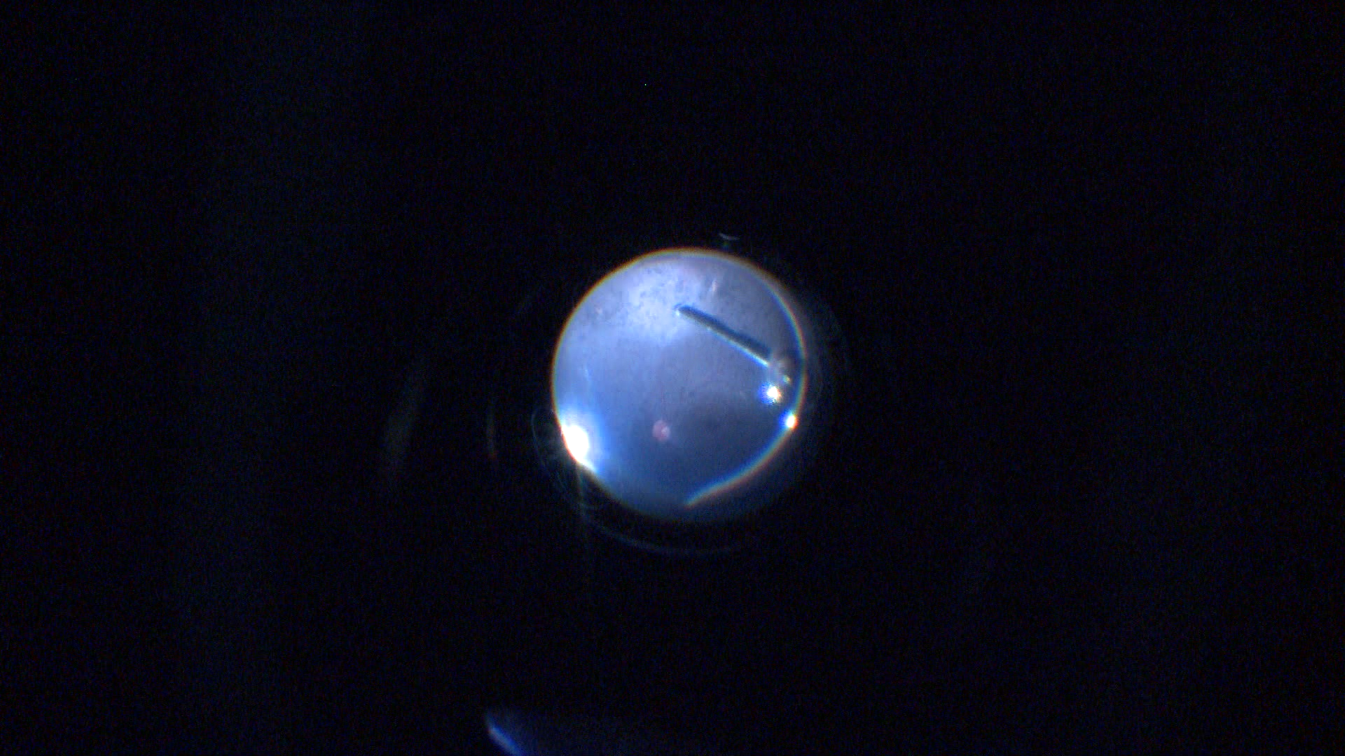

Slide 46
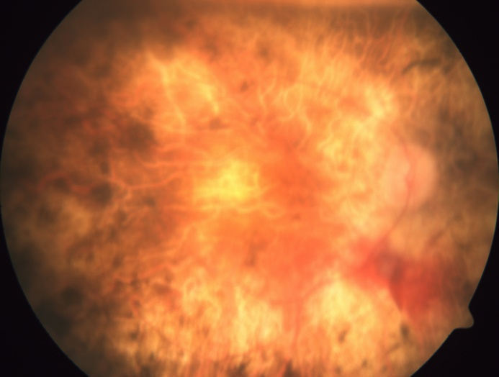
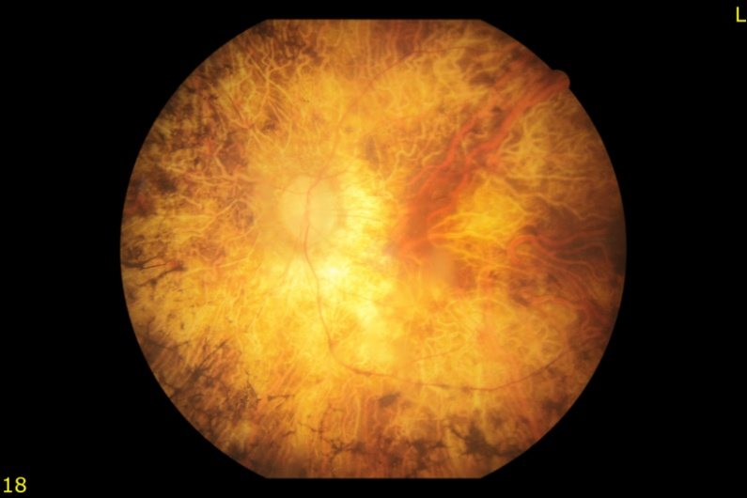
The same patient: Right eye 1 day after surgery and the left eye

Slide 47
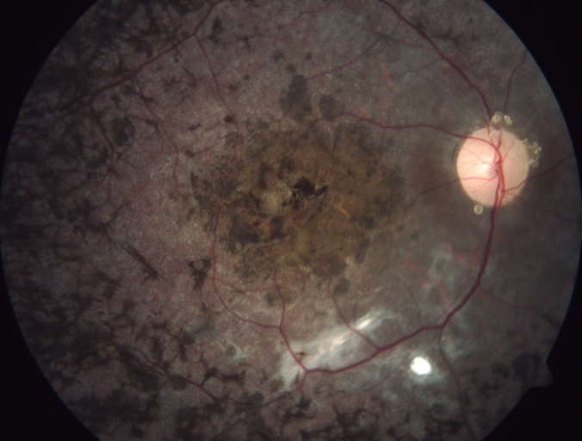
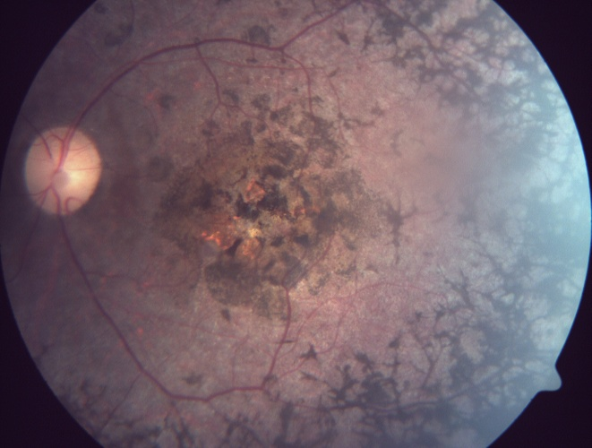
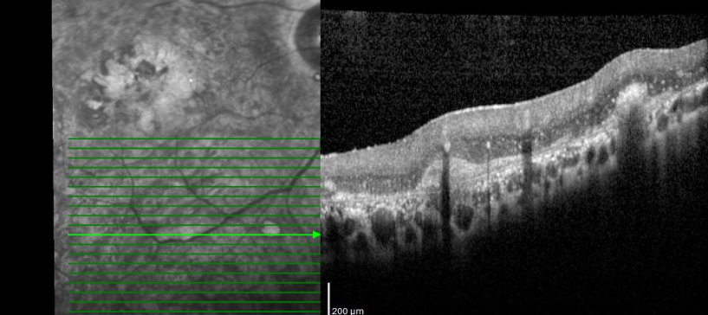
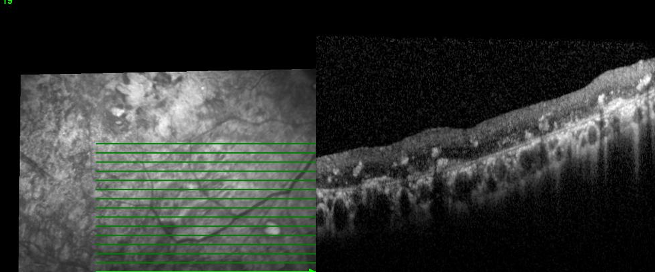
Fundus images of a patient at the sixth month
OCT at first week and at sixth month.
Right eye was treated, left eye was untreated.

Slide 48
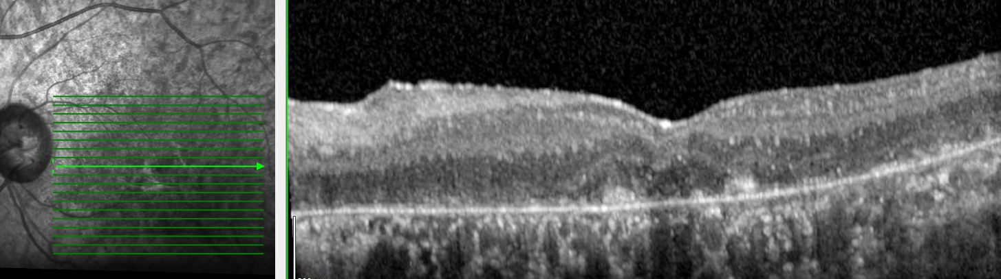
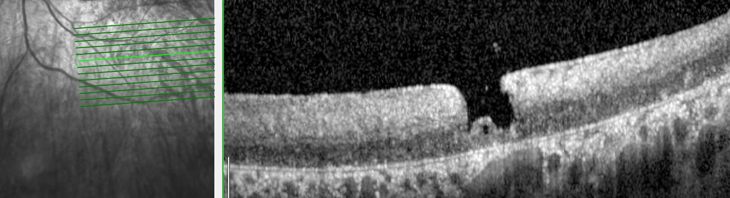
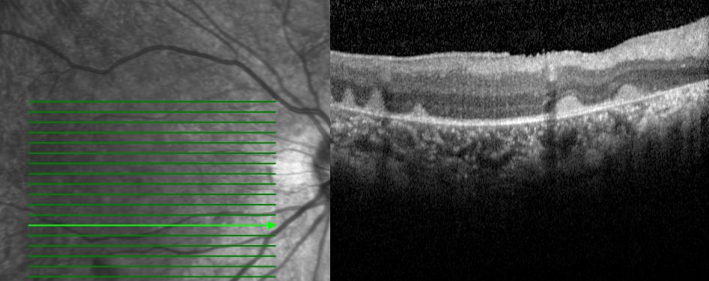
OCT image of a patient at sixth month
Transplantation area on OCT
OCT of another patient after 2 weeks

Slide 49
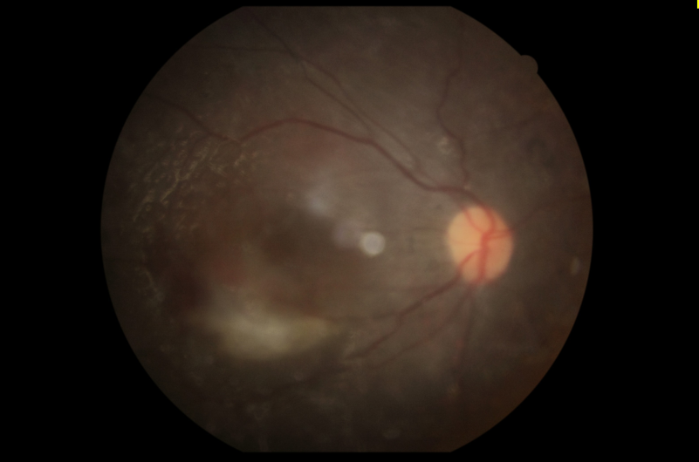
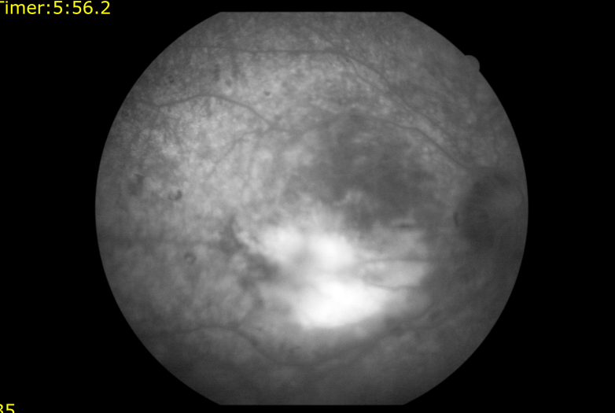
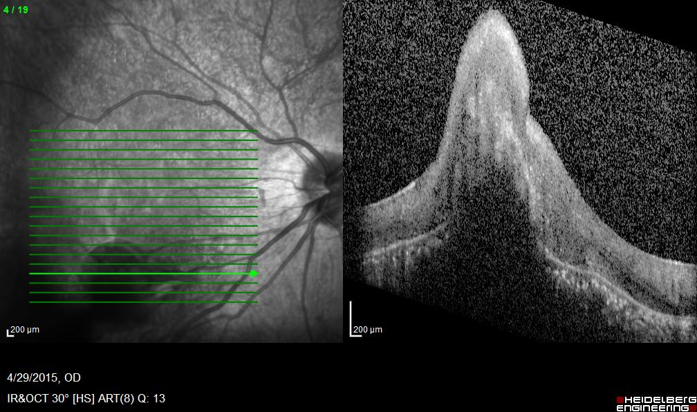
The patient with CNVM: Fundus image, angiography and OCT

Slide 50

CONCERNS ABOUT SC

Slide 51
SAFETY- Tumor Formation?
Despite all the advantages of SCs, (especially ESCs) tumor formation is considered an important risk for the clinical application of these stem cells.
In clinical studies there is no reported tumor formation yet.
Cui L, et al. WNT signaling determines tumorigenicity and function of ESC-derived retinal progenitors. J Clin Invest 2013; 123: 1647-1661.

Slide 52
IMMUN REACTION ?
SCs are known to be immunsupressive.
Subretinal region is belived to be immune privileged because of the presence of the blood–brain and blood–retinal barriers.
Immunosuppression is not necessary as long as the blood–retinal barrier was not damaged by the transplantation procedure.
Some researchers recommend immunsupressive drugs for human.
Hambright, D.; et al. Long-term survival and differentiation of retinal neurons derived from human embryonic stem cell lines in un-immunosuppressed mouse retina. Mol. Vis. 2012, 18, 920–936.

Slide 53
Low Rate of Cell Survival and Migration
But a low rate of transplanted cell survival is a major problem in stem cell therapy.
The diseases are progressive and stem cells could be affected from the disease.
OLM may presents a physical barrier to integration of stem cells into the retina.
Chen, L.F.; et al. Localization and developmental expression patterns of CSPG-cs56 (aggrecan) in normal and dystrophic retinas in two rat strains. Exp. Neurol. 2012, 234, 488–498.
Tucker, B.A.; et al. Transplantation of adult mouse iPS cell-derived photoreceptor precursors restores retinal structure and function in degenerative mice. PLoS One 2011, 6, e18992. 114.
Pearson, R.A.; et al. Targeted disruption of outer limiting membrane junctional proteins (Crb1 and ZO-1) increases integration of transplanted photoreceptor precursors into the adult wild-type and degenerating retina. Cell Transpl. 2010, 19, 487–503.
Jiang, C.; et al. Laser injury promotes migration and integration of retinal progenitor cells into host retina. Mol. Vis. 2010, 16, 983–990.
West, E.L.; et al. Pharmacological disruption of the outer limiting membrane leads to increased retinal integration of transplanted photoreceptor precursors. Exp. Eye Res. 2008, 86, 601–611.

Slide 54
STANDART PROTOCOL?
Which kind of stem cell is most suitable for stem cell therapy?
What is the perfect dosage?
What is the most suitable way ? Subretinal, intravitreal?
What is the most suitable stage for patients to received the cells?

Slide 55
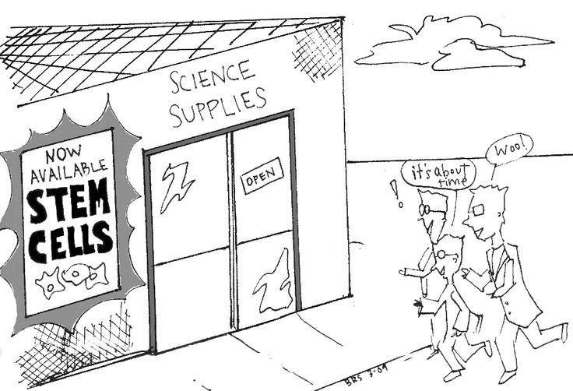
IN THE FUTURE

Slide 56

THANK YOU FOR YOUR İNTEREST

