Slide 1
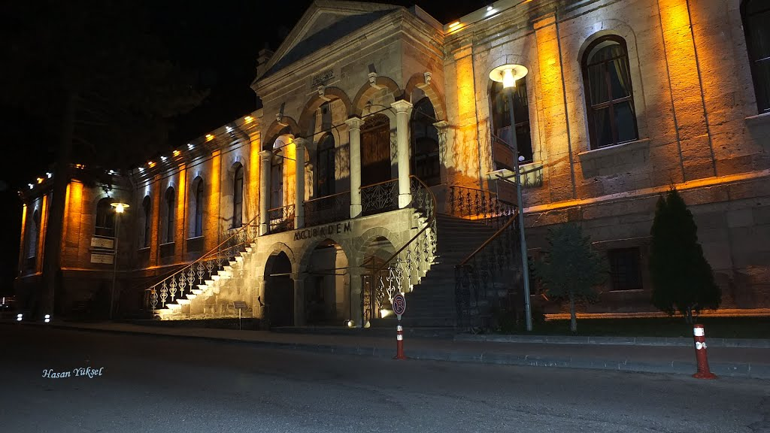
The therapeutIc effect of subtenon InjectIon of autologous platelet-rIch plasma In retInItIs pIgmentosa
Dr. NESLİHAN SİNİM KAHRAMAN febo
Prof. dr. ayşe öner febo
Acıbadem kayseri hospital

Slide 2
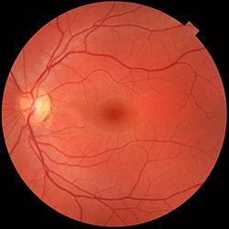
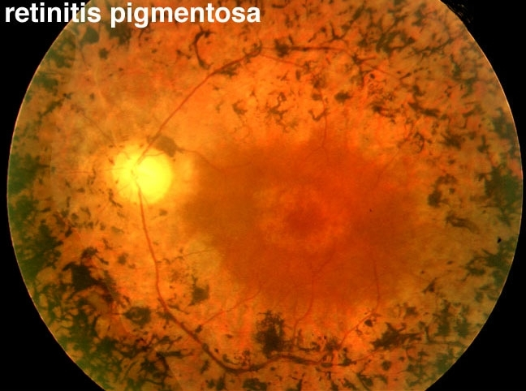
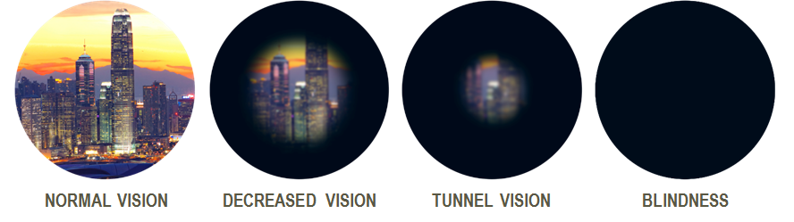
AIM
Retinitis pigmentosa (RP) is a hereditary retinal dystrophy of photoreceptors and an important cause of severe vision impairment.
It might cause potential blindness by age 40-50.
The presence of nyctalopia, visual field construction from periphery to the fovea, bone spicule pigmentation in the retina and a reduction in electroretinograms (ERG) are seen as the findings of the disease.
Even if the mechanisms of retinal cell death can be different, photoreceptor apoptosis is the final outcome in the disease course.

Slide 3
In the eye, fibroblast growth factor(FGF), neural growth factor(NGF), ciliary neurotrophic factor (CNTF), brain-derived neurotrophic factor (BDNF) and glial cell line-derived neurotrophic factor (GDNF) are known with their neurotrophic effects.
Application of these factors may block the apoptotic cascade of retinal cells.
Experimental studies showed that and neurotrophins can significantly decelerate retinal degeneration and cell death.

Slide 4
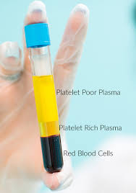
Recently, blood-derived products have been mostly used in ophthalmology as a GF source.
These products can increase healing process and accelerate the regeneration of various tissues by supplying GFs and other active biomolecules from the blood.
Topical autologous serum was widely-used and found to be effective in the treatment of various ocular surface diseases.
Platelet rich plasma (PRP) contains higher concentrations of essential GFs and cell adhesion molecules than autologous serum.
In this clinical study, the primary aim was to evaluate the effects of aPRP on BCVA, VF, and ERG; the second aim was to evalute the duration of the therapy effect and the need for additional aPRP injection.

Slide 5
METHOD
This clinical study included 154 eyes of 77 RP patients attending to the ophthalmology clinic of our hospital.
The inclusion criteria were as follows:
1) Clinical diagnosis of RP confirmed by clinical history, fundus appearance, VF, OCT and ERG
2) subjects older than 18 years of age
3) subjects who are able to do a reliable VF evaluation
4) subjects who have at least 1 year-follow-up results

Slide 6
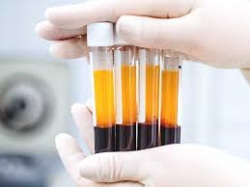
Preparation of Autologous PRP
In our study, peripheral blood of 15 ml from RP patients was collected using blood collection tubes and centrifugation was done with 2500 rpm for 15 minute at room temperature within a blood collection period of 10 minutes.
After this centrifugation process the plasma was separated from the other part of blood components.
After topical anesthesia aPRP solution was injected from inferotemporal quadrant into the subtenon space of each eye.
Each patient received three injections with 4-week intervals between each injection.

Slide 7
The patients were examined every 3 months for at least 10 months after the third injection; thus, the total duration of the study for each patient was 1 year.
The examinations and the tests of the patients including OCT and VF were obtained before the injection, 1 month after the third injection and at every visit until the end of the first year.
Additional aPRP injections were done if a detoriation in the VF and visual functions was detected.

Slide 8
RESULTS
The mean BCVA of the 154 studied eyes before treatment was 0.22±0.18 snellen lines.
It improved to 0.31±0.19 following three monthly aPRP applications which was statistically significant (p<0.05).
At the end of the follow-up period the mean BCVA decreased to 0.27±0.22, the result was not statistically significant when compared to baseline.

Slide 9
Visual field values were obtained in all eyes. Statistically significant VF improvement was detected after 3 monthly injections when compared to pre-injection values and the improvement continued in most of the patients during the study period (p<0.05).
When compared with pretreatment values we found no statistically significant difference in the b wave amplitudes and latencies of rod response, maximal combined response and cone response after Aprp injections and at the final examination (p > 0.05).

Slide 10
FIg.1 A-F: VIsual fIeld changes after aPRP InjectIons. FIgure A, C, E: Before aPRP applıcation; Fıgure B, D, F: After 3rd aPRP applıcatıon: Note the ımprovement in VF test. These patıents dıd not receive any addıtıonal ınjectıons

Slide 11
Fig.2 A-I: Vısual fıeld changes after aPRP ınjectıons. Fıgure A,D,G: Before aPRP applıcatıon,
Fıgure B,E,H: After 3rd aPRP applıcatıon, fıgure C,F,I: 3 months after 3rd aPRP applıcatıon. These patıents receıved addıtıonal ınjections because of the detorıatıon ın the VF test

Slide 12
DISCUSSION
The deprivation of GFs leads to the induction of apoptosis mechanism
At the beginning, retinal cells decelerate their metabolic activities.
If the GF insufficiency persists, the apopitosis process of the photoreceptors take place.
This raises the possibility that gfs may play an inhibitory role in the apoptosis process and GF levels may be essential in maintaining viability of cells undergoing apoptosis.

Slide 13
Various factors such as ciliary neurotrophic factor (CNTF), brain-derived neurotrophic factor (BDNF), pigment epithelium-derived factor (PEDF), glial cell derived neurotrophic factor (GDNF) have been investigated in experimental studies and demonstrated to rescue the retinal structure.
Because photoreceptors are thought to be a part of central nerve system, neurotrophic factors might be beneficial for retinas of RP patients to preserve retinal cells.

Slide 14
Since 1998, platelet-derived products have been widely used in regenerative medicine.
These products included many bioactive molecules such as epidermal growth factor (EGF), PDGF, VEGF, insulin-like growth factor (IGF-1) and fibroblast growth factor (FGF) which took part in tissue repair and wound healing process.
A clinic study showed that aPRP injections was thought to promote the survival of retinal cells, this study suggested that the patients experienced improvements in VF, mferg, and microperimetry results after aprp injections however, there was no significant changes in visual acuity.

Slide 15
conclusıon
We found improvements in VA and VF evaluations of our patients.
However the improvement in VA after three apPRP injections detoriated in nearly half of the patients after 3 months and the patients needed additional injections.
The effect of the treatment seems to be preserved for at least 3 months.

Slide 16


