Slide 1
Delivery of Stem Cells to the retina: research findings and trends
PROF DR AYSE ONER, FEBO et al.
ERCIYES UNIVERSITY
MEDICAL FACULTY
OPHTHALMOLOGY DEPT.
KAYSERI –TURKEY

Slide 2
WHAT IS STEM CELL
Stem cells are unspecialized cells
They can give rise to specialized mature cells.
They are highly proliferative.
They have the potential to repair tissue and restore function after injury.

Slide 3
Mechanisms of Action
1. Cell replacement: Healthy stem cells can replace unhealthy or lost stem cells.
2. Nutritional support: Healthy stem cells increase support to surrounding cells by secreting growth factors.
3. Anti-apoptosis: Stem cells can regulate the degeneration of retinal cells and vessels by inhibiting apoptosis.
4. Synapse formation: They can create new synaptic connections.

Slide 4
NUTRITIONAL SUPPORT
Stem cells secrete some trophic factors and for the survival of surrounding cells.
Proangiogenic factors: Angiogenin, PLGF
Angiogenic chemokines: CXCL1, CXCL,CXCL5,CXCL6 ve CXCL8
Angiogenic growth factors: HGF, bFGF, VEGF-D, PDGF-AA, TGF-𝛽2, G-CSF, TGF-𝛽2
Neurotrophic factors: bFGF, nerve growth factor (NGF), neurotrophin 3 (NT3), neurotrophin 4 (NT4), glial-derived neurotrophic factor (GDNF)

Slide 5
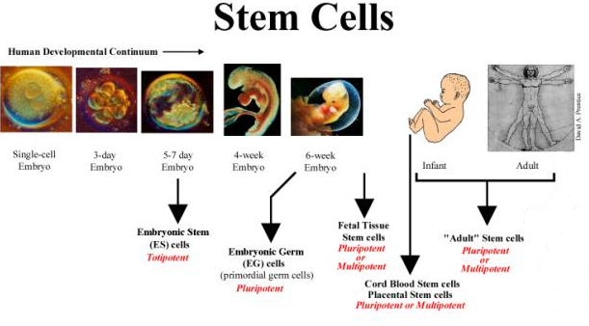
TYPES OF STEM CELLS
1- Embryonic stem cells (ESC)
2- Adult Stem Cells
- Mesenchymal Stem Cells (MSC)
(Adipose Tissue, Bone marrow, Umblical cord)
- Induced pluripotent stem cells (IPSC)

Slide 6
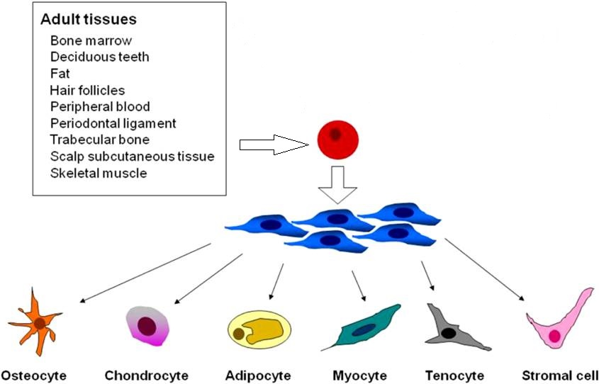
ERİŞKİN KÖK HÜCRE KAYNAKLARI

Slide 7
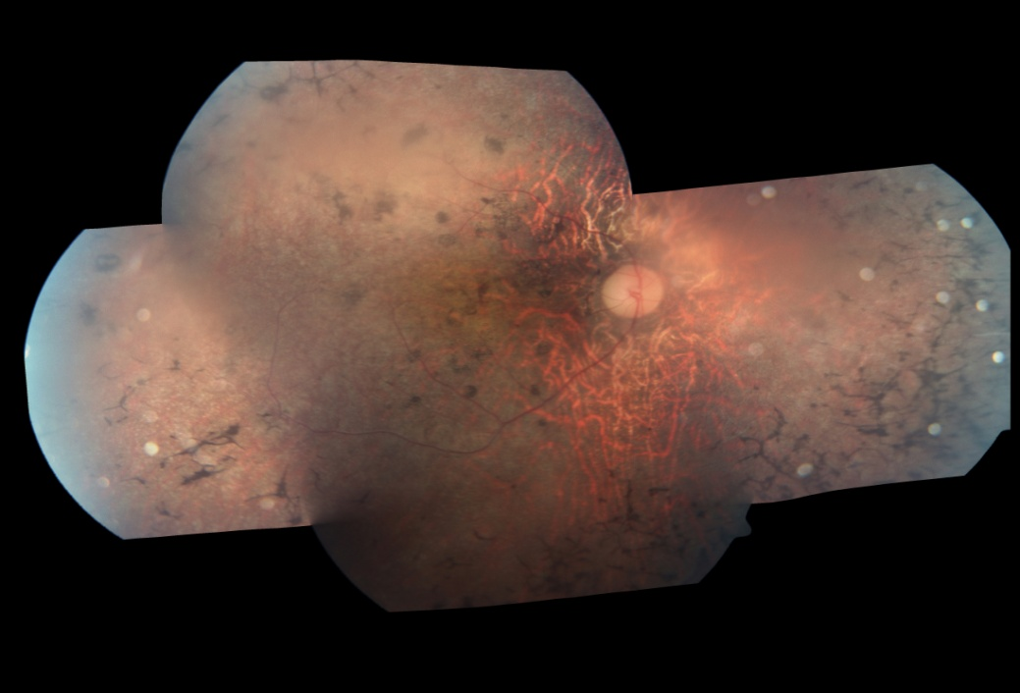
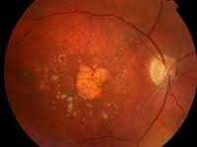
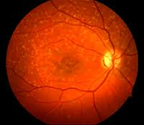
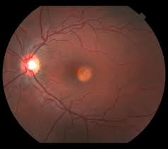
TARGET DISEASES OF STEM CELL IMPLANTATION
HEDEFLENEN RETİNAL HASTALIKLAR
RP, LCA, AMD, BEST, STARGARDTS’ OPTIC NERVE DISEASES

Slide 8
Stem Cell And Eye
There are numerous advantages of stem cell therapy in the eye.
The amount of stem cells required is low, which is important in terms of cost.
The surgical approach is quite easy, and the transplanted cells can be easily monitored with the imaging methods.
The fellow eye can be used as a control.
Long-term immunosuppressive treatment is not required due to the immune privilege of the eye.

Slide 9
TYPES OF STEM CELLS FOR EYE
ESCs,
IPSCs,
MSCs (bone marrow, adipose tissue and umblical cord tissue)

Slide 10
Surgical Approach For Stem Cell
1- Intravitreal
2-PPV and Subretinal
3- Suprachoroidal
4-Retrubulbar/Subtenon
5-Intravenous

Slide 11
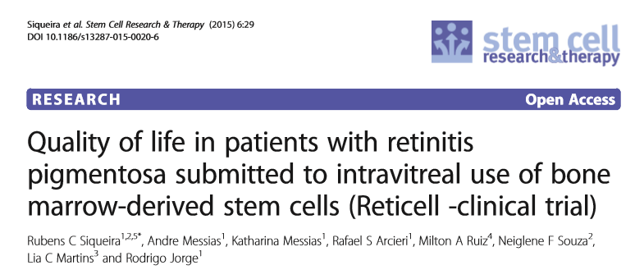
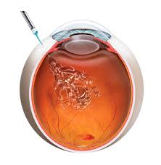
1- Intravitreal Implantation
-MSCs were applied intravitreally to 20 patients who were followed for 1 year.
-The authors reported a statistically significant improvement in the patients’ vision related quality of life .

Slide 12
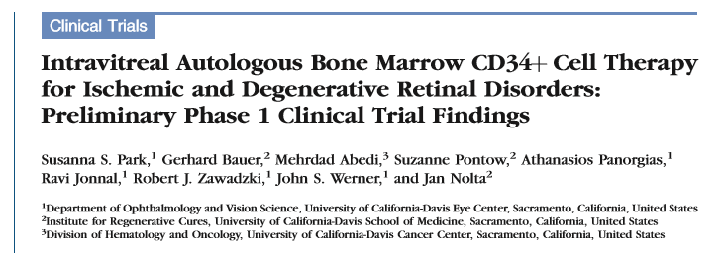
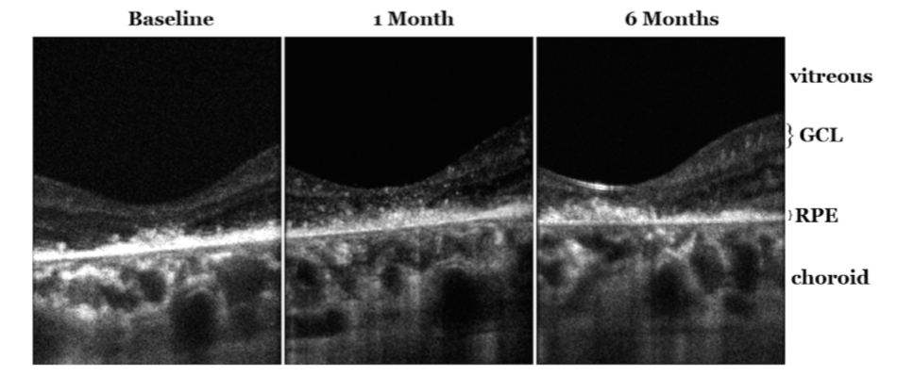
IOVS- January 2015
Increase in hyperreflectivity on OCT

Slide 13
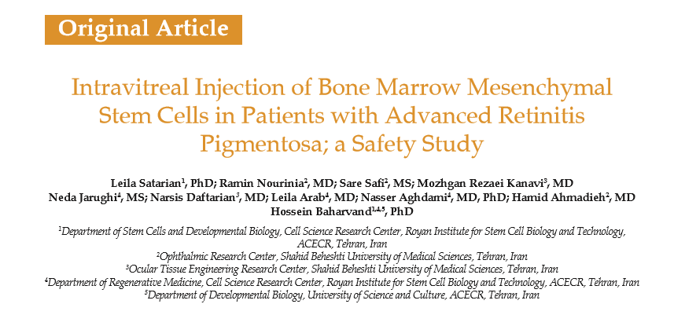
- Vision improvement and no adverse events were observed in eyes of 2 patients.
- Severe fibrous tissue proliferation, tractional retinal detachment (TRD), iris neovascularization and formation of mature cataract was observed in one patient.

Slide 14
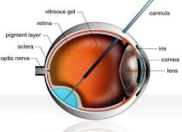
2- SUBRETINAL IMPLANTATION
SC Suspension or SC Sheet

Slide 15
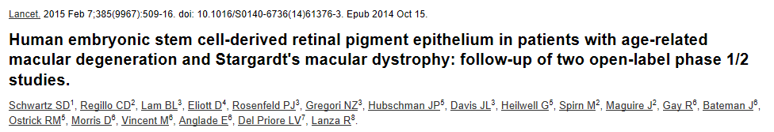
Subretinal transplantation of hESC-derived RPE
9 patients with Stargardt's macular dystrophy , 9 patients with atrophic AMD
Followed up for a median of 22 months
No serious ocular or systemic safety issues related to the transplanted tissue.
13 of 18 patients had patches of increasing subretinal pigmentation.
VA improved in 10 eyes, improved or remained the same in 7 eyes, and decreased in 1 eye

Slide 16
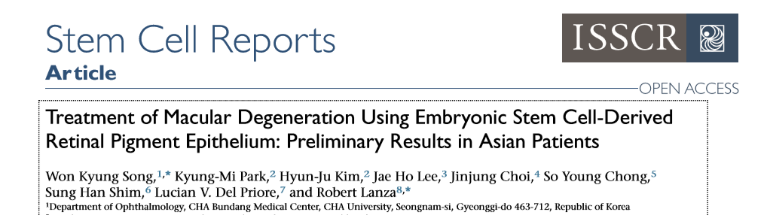
4 AMD, 4 Stargardt MD cases, 1 year follow-up
Subretinal hESC-derived RPE
No serious adverse event, no systemic side effect
CNVM in one patient , received 3 Lucentis
Increase in pigmentation in all cases
VA increase in all cases

Slide 17
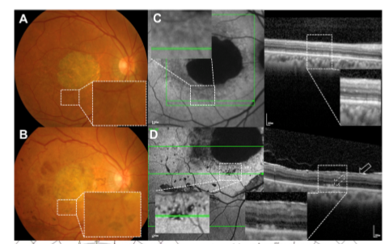
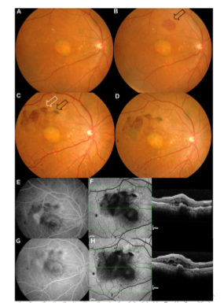
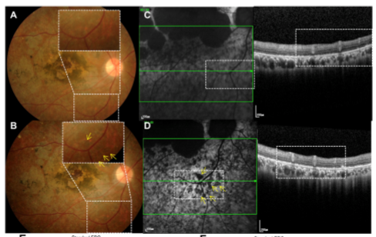
CNVM in 1 case
Subretinal pigmentation

Slide 18
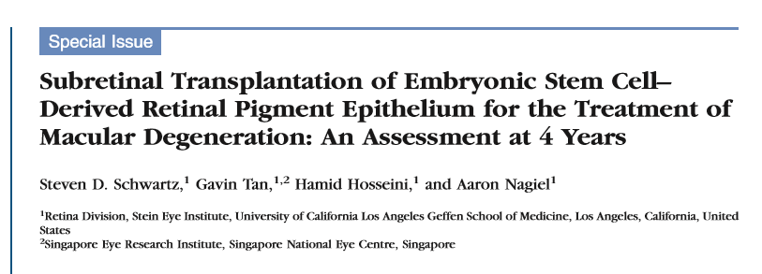
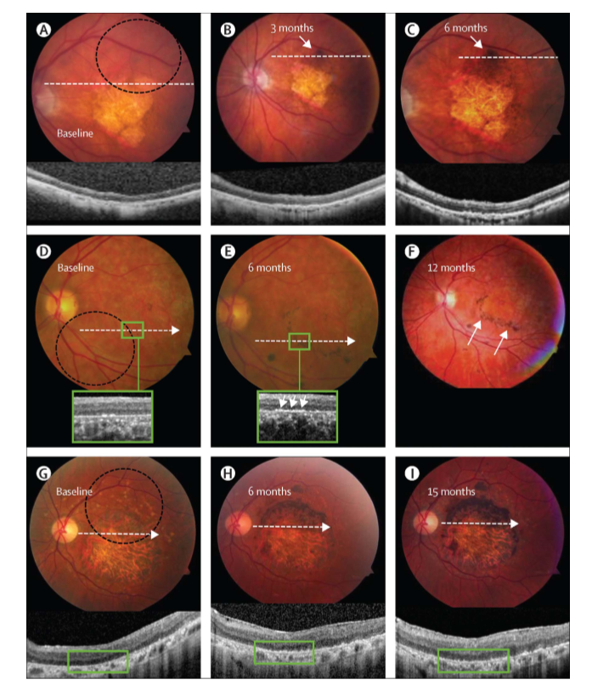
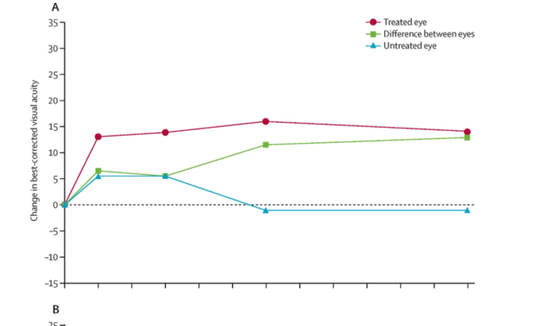
VA improvement in the treated eye

Slide 19
DISADVANTAGES OF SUBRETINAL IMPLANTATION
Uncontrolled bleb extension
Cell reﬂux out of the bleb through the retinotomy and into the vitreous cavity.
Reﬂux of cells may result in signiﬁcant loss of efﬁcacy and potentially side effects of cells being in the vitreous, for example, development of epiretinal membranes or retinal traction.
The migratory potential of transplanted cells is not well appreciated.

Slide 20
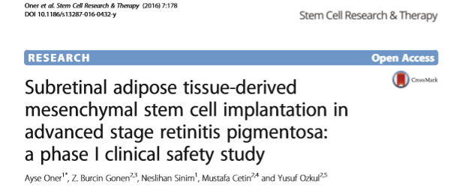
PHASE 1 STUDY OF OUR GROUP
Subretinal ADMSC implantation in 14 advanced RP patients

Slide 21

Subretinal Stem Cell Injection via 41 subretinal cannula (From our study)

Slide 22
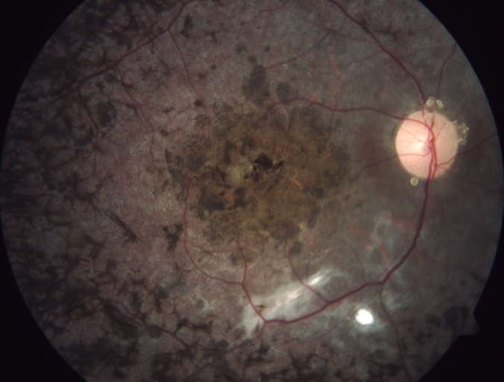
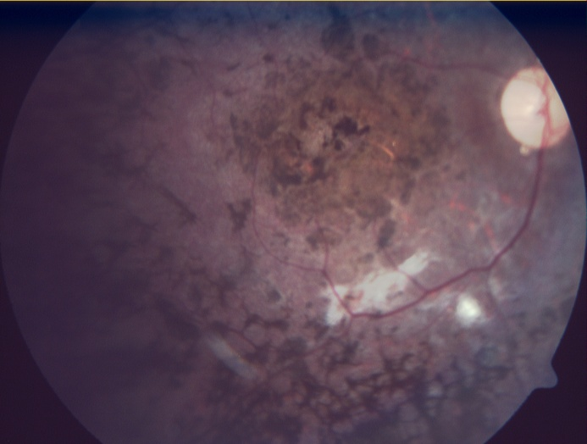
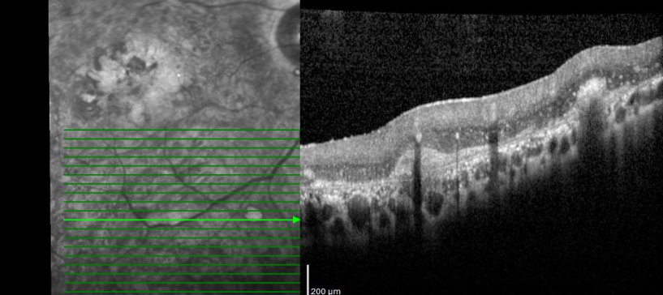
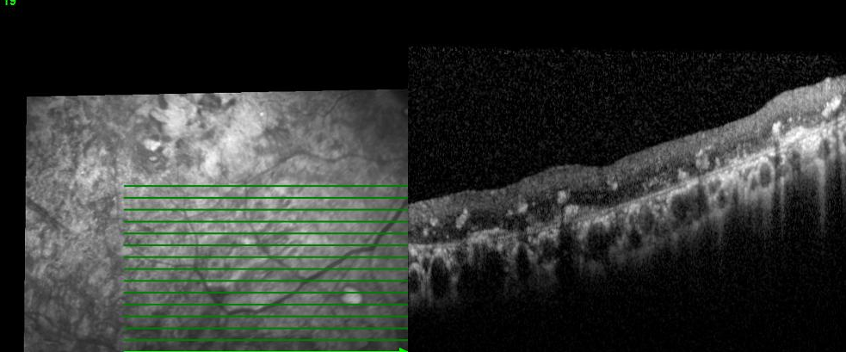
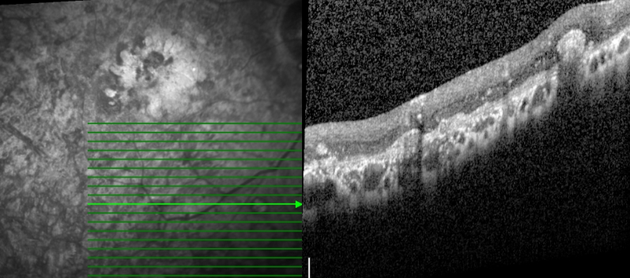
6. Month
4 years
OCT scans of injection area, 1 month, 1 year, 4 years

Slide 23
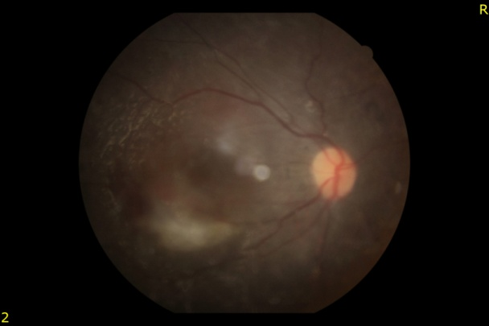
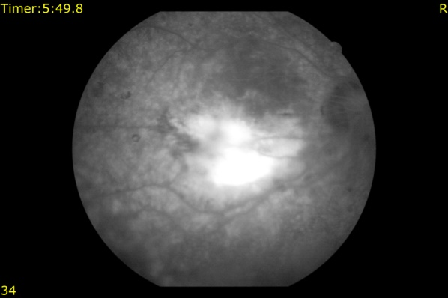
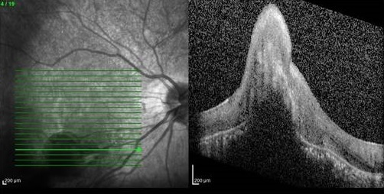
RESULTS OF OUR STUDY
None of the patients had systemic complications.
Eight patients had no ocular complications.
One of the patients experienced choroidal neovascular membrane (CNM) and received intravitreal anti-VEGF drug.
IMAGINGS OF THE PATIENT WITH CNVM

Slide 24
The first operated six patients had epiretinal membrane (ERM) with localized peripheral tractional retinal detachment at the periphery which required second vitrectomy.
OCT OF A PATIENT WITH ERM AND OCT AFTER SECOND SURGERY

Slide 25
Mild band keratopathy developed in one of these patients after six months and retrolental fibrous tissue was found in another patient after 12 months.
RETROLENTAL FIBROUS TISSUE

Slide 26
Development of these membranes and fibrous tissue is thought to be due to the vitreal reflux or inadvertent preretinal injection and unwanted preretinal proliferation of MSCs.
To prevent the occurance of this complication, the operation technique was modified (multıple air-fluid exchange to clear the MSC).This modification inhibited membrane formation in the remaining eight patients.

Slide 27
Four patients experienced visual acuity improvement during the first year.
The patients with visual acuity improvement were young with a relatively short duration of disease.

Slide 28
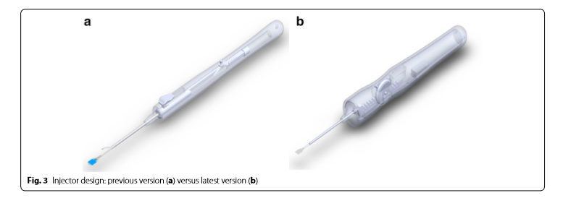
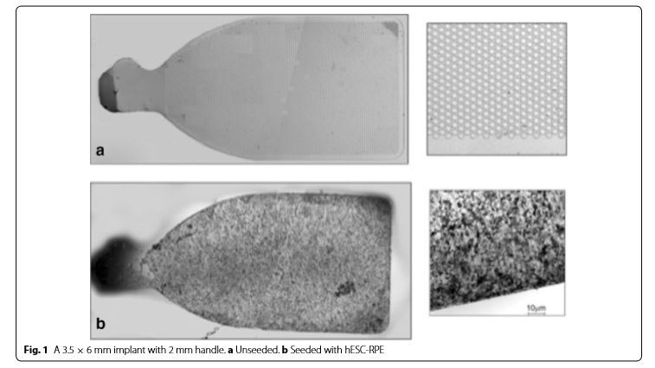
SUBRETINAL RPE SHEET INJECTION
THE INJECTOR
RPE SHEET

Slide 29
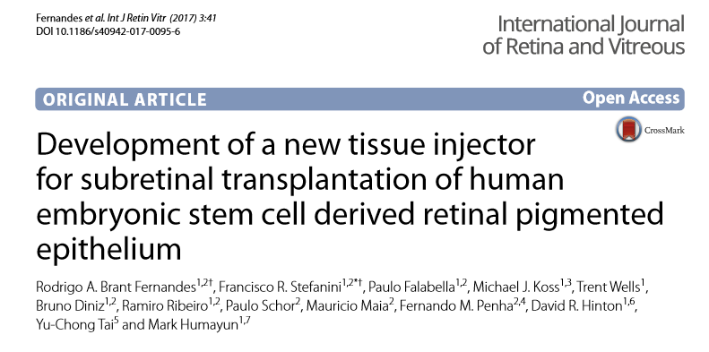

Slide 30
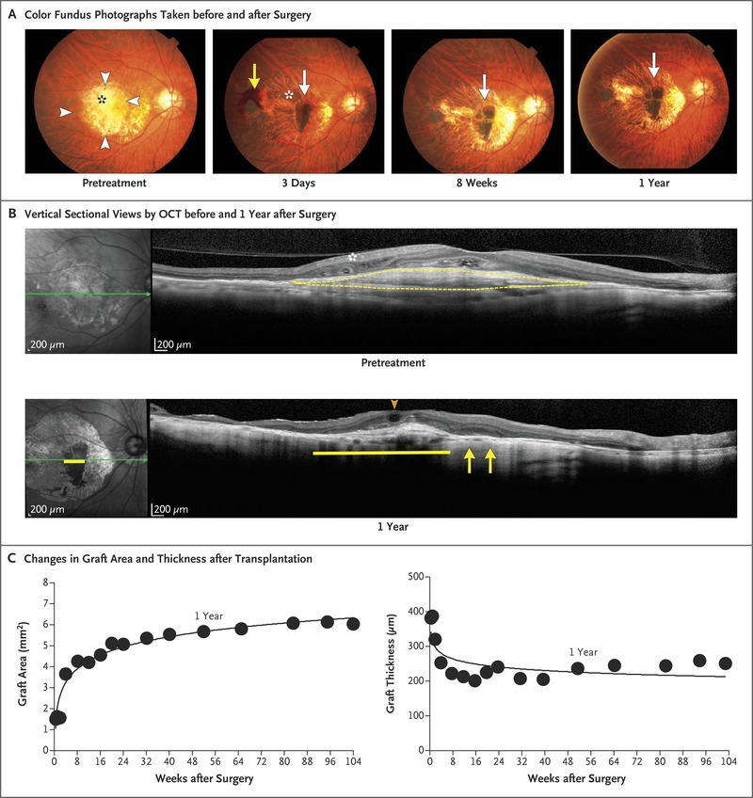
A PATIENT WHO RECEIVED SUBRETINAL RPE SHEET

Slide 31
3- SUPRACHOROIDAL
1: Suprachoroidal cannulation via silicone catheters (MicroTrac catheter; i Science Interventional, Menlo Park, CA)
2: Limoli Technique (You will listen from the master)
Safer than vitrectomy plus subretinal injection
There is no removal of the vitreous and no iatrogenic retinal hole.

Slide 32
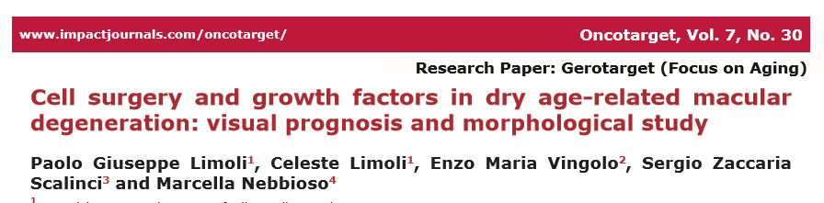
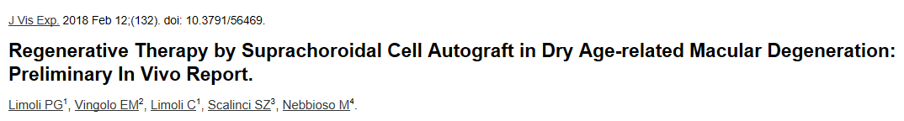
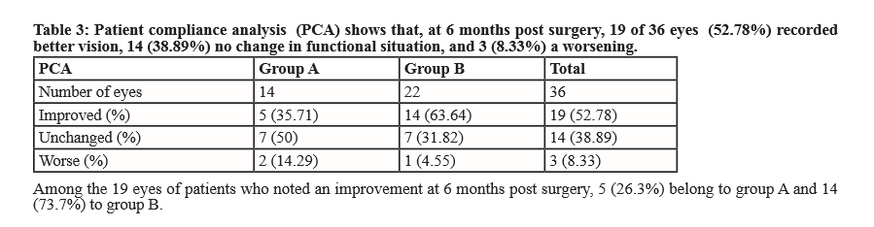
LIMOLI TECHNIQUE

Slide 33
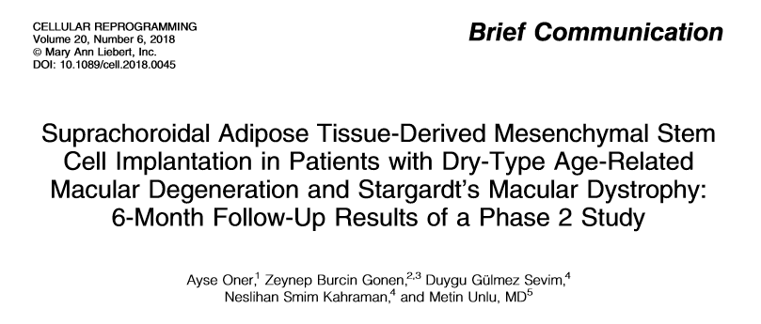
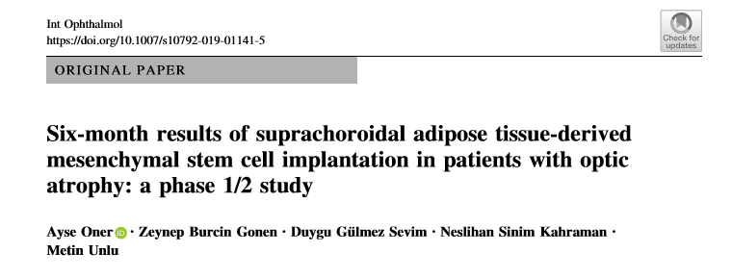
PUBLICATIONS OF OUR GROUP

Slide 34
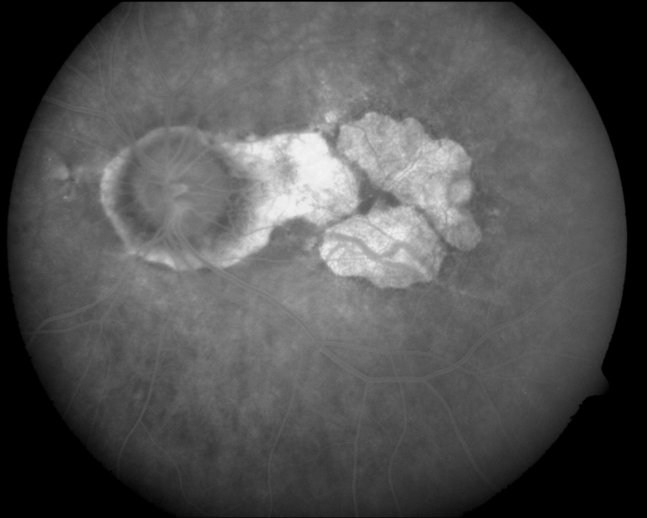
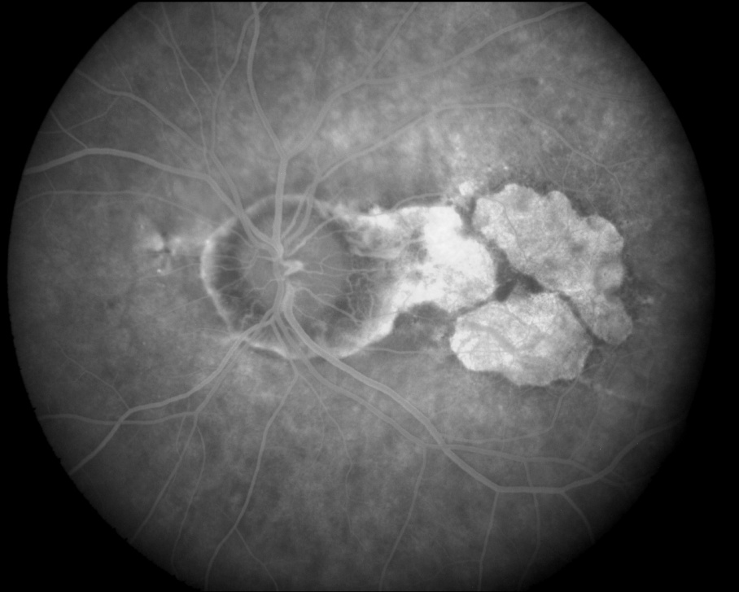
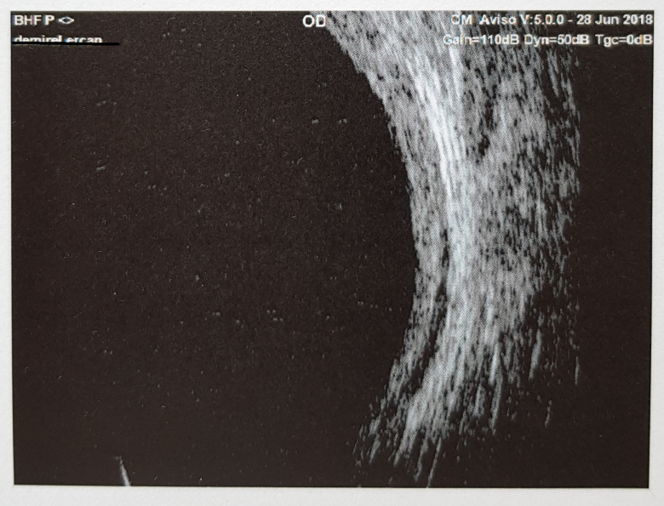
USG of the fleb area

Slide 35
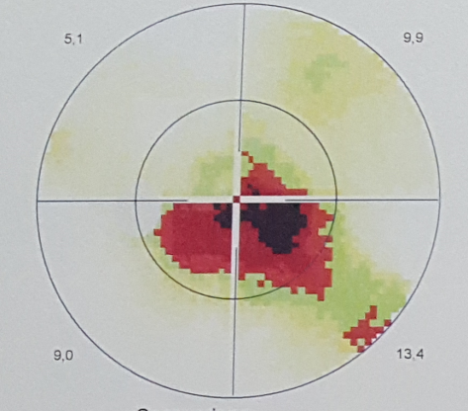
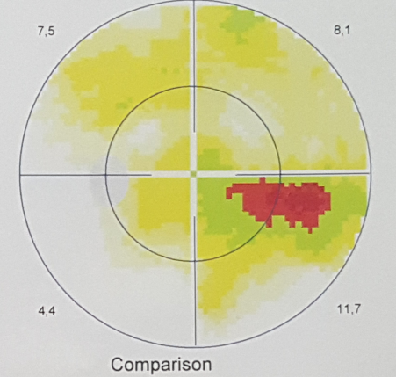
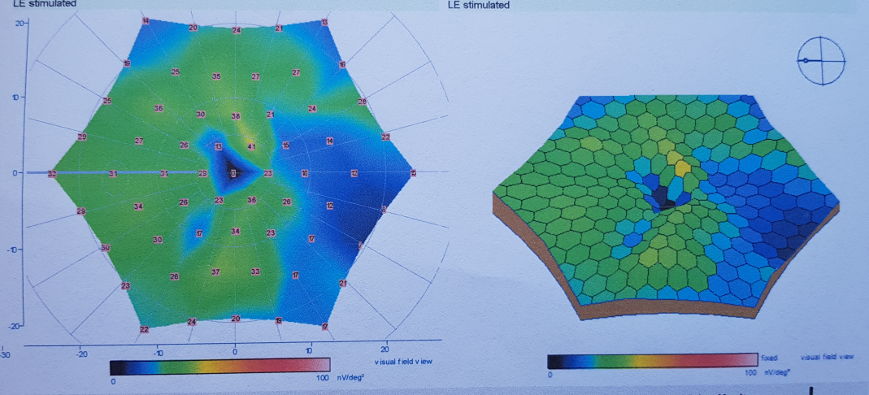
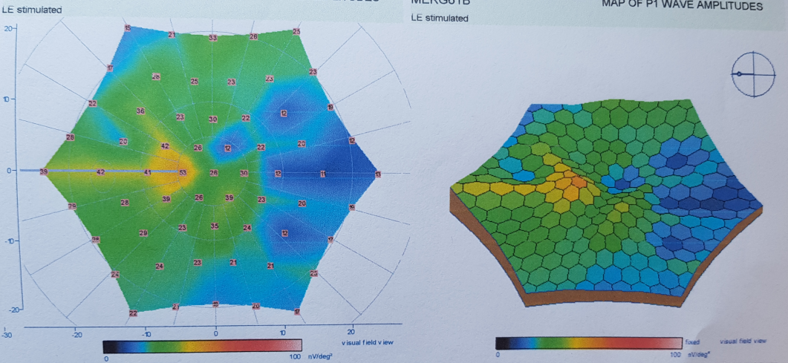
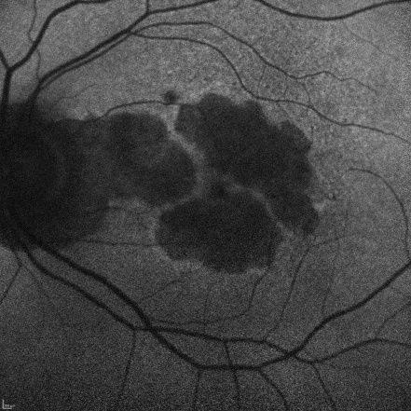
BEFORE
OLGU- YBMD
AFTER
65 yrs old male, AMD
VA: From 1 mcf to 0.05
VISUAL FIELD, ERG,OCT

Slide 36
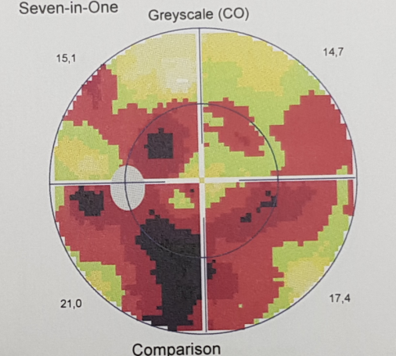
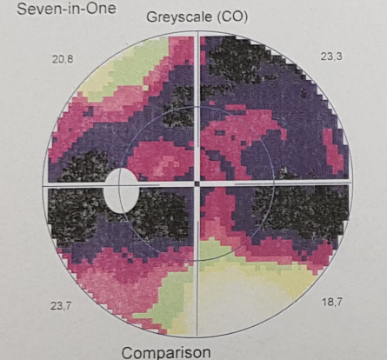
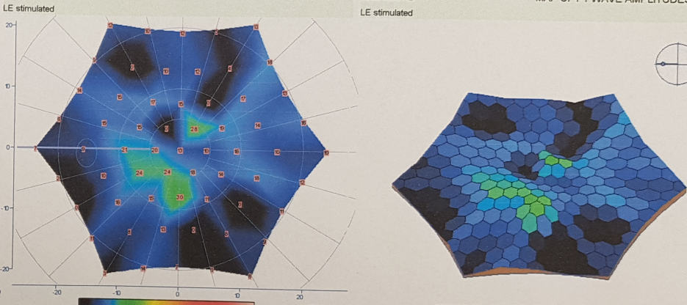
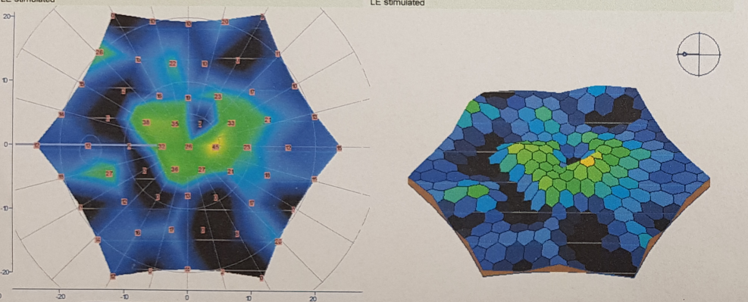




BEFORE
AFTER
27 yrs old female
VA: From1 mcf to 0.05
VISUAL FIELD, ERG,OCT

Slide 37




56 yrs old male, AMD
BEFORE
AFTER
VA: From 0.4 to 0.7.

Slide 38




48 yrs old female RP. GA: From 0.4 to 0.6
BEFORE
AFTER

Slide 39
4,5- Subtenon, Intravenous
SCOTS: Stem Cell Ophthalmology Treatment Study
3 Arms in SCOTS
1- Intravitreal+ Intravenous
2- Subtenon/Retrobulbar+Intravenous
3- Subretinal/Intra optic nerve+Intravenous

Slide 40



Slide 41


2018-Haziran

Slide 42
CONCLUSIONS:
The results of the first clinical studies provide evidence of beneficial effects of stem cell implantations in degenerative retinal and optic nerve diseases.
To optimize the cell delivery technique and to evaluate the effects of SC therapy on visual acuity and the quality of life of these patients, future studies with larger number of cases will be necessary.

