Slide 1
The Effects of Anti-VEGF Drugs on Retinal Pigment Epithelial Cell Culture
Ayşe Oner, et al.
The authors have no financial interest to disclose

Slide 2
Materials and Methods
Aflibercept (0.5 mg/ml), bevacizumab (0.3125 mg/ml) and ranibizumab (0.125 mg/ml) were applied to the RPE cell cultures which were isolated from the enucleated eyes of New Zealand white rabbits.
The effects on viability, apoptosis, proliferation, and senesence of the cells were evaluated in the control and drug applied cultures at the end of 72 hours.

Slide 3
Results
There was a statistically significant increase in the viability and decrease in the apoptosis of the cells in aflibercept applied culture when compared to the control group (p <0.05).
There was a statistically significant increase in apoptosis and decrease in viability in the bevacizumab and ranibizumab-treated groups compared with the control group (p <0.05).
There was not a difference between groups when evaluating the effects on cell proliferation and senescence (p> 0.05).

Slide 4
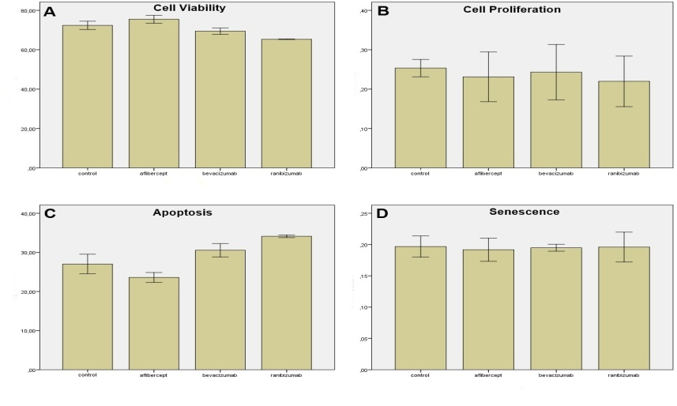
Effects of aflibercept, bevacizumab or ranibizumab on RPE cell culture. Bar graphs represent cell viability (A), cell proliferation (B) apoptosis (C) and senescence (D) expressed as arbitrary units 72 h after supplementation with aflibercept (0.5 mg/ml), bevacizumab (0.3125 mg/ml) and ranibizumab (0.125 mg/ml). (A) Bevacizumab and ranibizumab decreased the cell viability, on the contrary aflibercept increased the cell viability compared with the control group. (B) No anti-VEGF drug showed significant negative effect on cell proliferation at the end of 72 hours. (C) Apoptosis was augmented by incubation with bevacizumab and ranibizumab, on the contrary aflibercept significantly decreased apoptosis compared with the control group. (D) No anti-VEGF drug showed significant effect on senescence at the end of 72 hours.

Slide 5
Conclusion
-Our study showed that anti-VEGF drugs had no effects on senescence and proliferation of RPE cells.
-Aflibercept was found to decrease the apoptosis and increase the viability of the cells.
-In contrast, ranibizumab and bevacizumab was observed to increase the apoptosis and reduce the viability of RPE cells.
-In the literature, there are no studies evaluating the effects of anti-VEGF drugs on senescence. We believe that our study will guide future studies in this respect.

